Slide 1
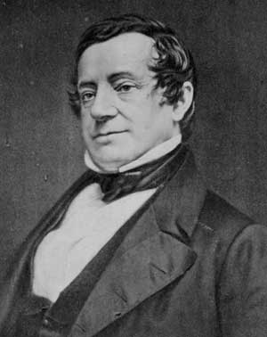
Washington Irving: “The Devil and Tom Walker” 1783-1859

Slide 2
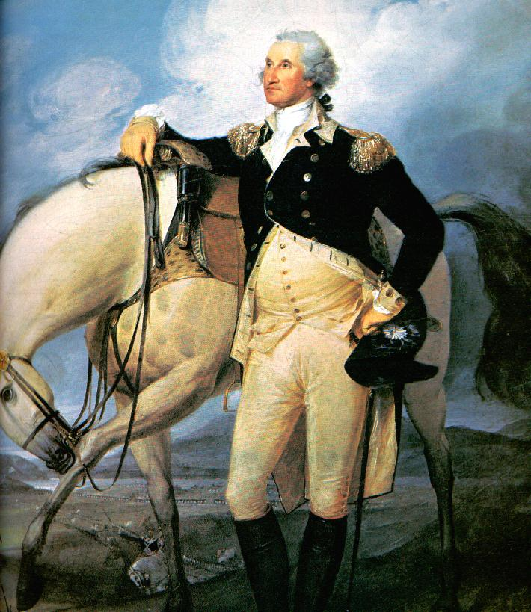
Background
Named after George Washington
He was the first American writer to achieve international recognition.

Slide 3
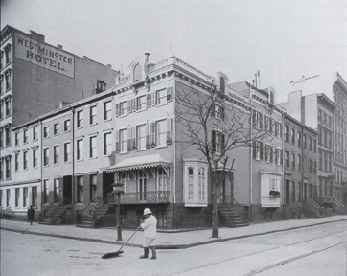
Background Part II
He was born into a wealthy family; supposed to become a lawyer.
Spent a great deal of time exploring the Hudson Valley
(setting of many of his stories)

Slide 4
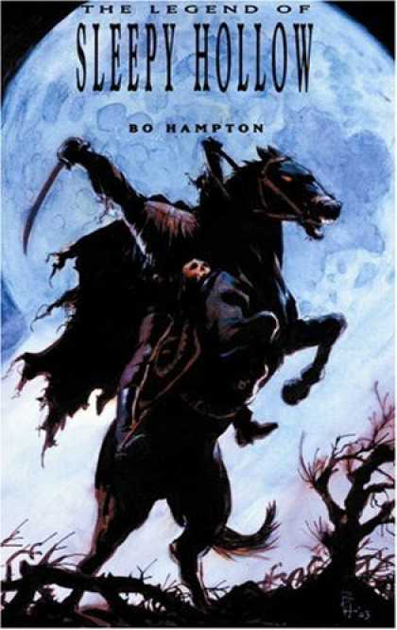
Irving’s Style:
Many of Irving’s stories, such as “The Legend of Sleepy Hollow” and “Rip Van Winkle” were based on German tales.

Slide 5
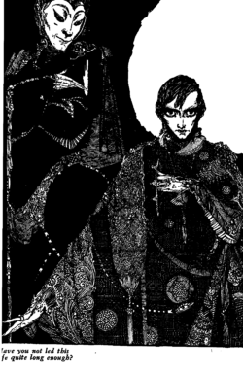
Faust Legend:
“The Devil and Tom Walker” is based on the Faust legend.
Dates back to 1500s.
An astrologer Dr. Faust sells his soul to the devil in exchange for power and money.

Slide 6
Literary Analysis:
Third person omniscient point of view: all knowing narrator relates the events of the story.
Knows characters inner most thoughts and feeling
Stands outside the action
Comments about events in the story

Slide 7
Literary Analysis:
Characterization: creating and developing a character.
a. direct characterization: writer states what a character is like
b. indirect characterization: reveals traits through the characters thoughts and actions

Slide 8
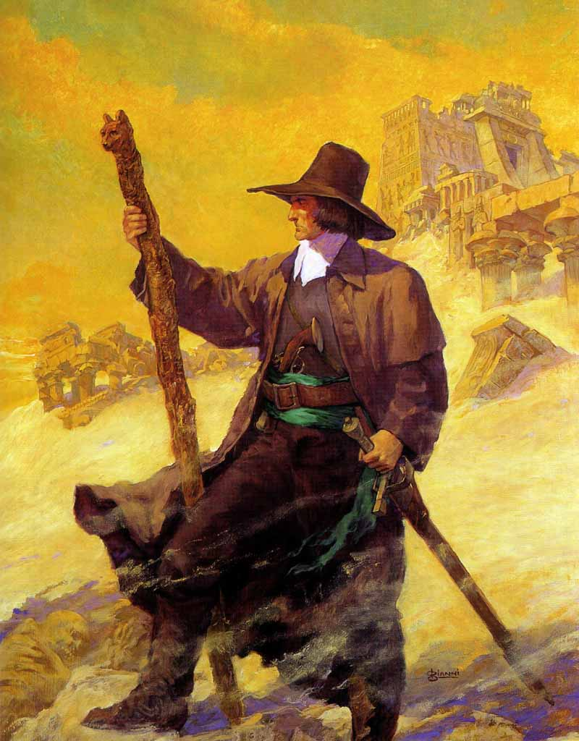
Reading Strategy
Inferring cultural attitudes. ( what a certain cultural group believed and did)
Irving suggests the attitudes through descriptive details, comments, and dialogue. (Puritans)

Slide 9
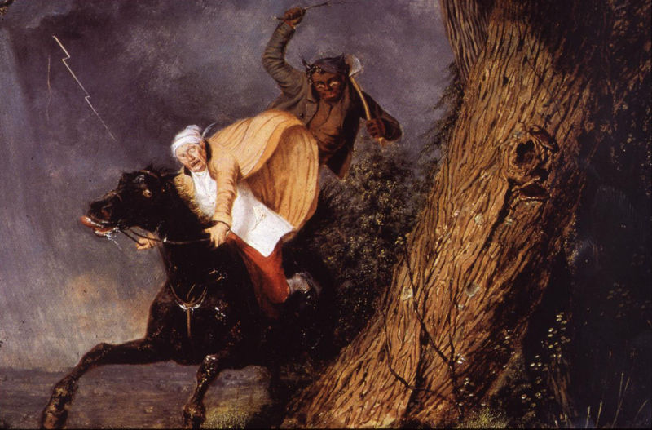
Setting
The Devil and Tom Walker”
New England
1700’s

