Slide 1
The Interlopers by Saki
Feature Menu
Introducing the Selection
Literary Focus: Omniscient Narrator
Reading Focus: Drawing Conclusions
Writing Focus: Think as a Reader/Writer

Slide 2
The Interlopers Introducing the Selection
What does it take to get two enemies to overcome their differences?

Slide 3
The Interlopers Introducing the Selection
Click on the title to start the video.

Slide 4
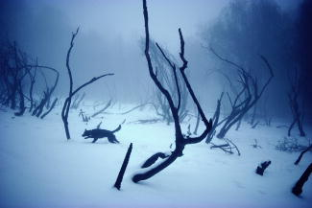
The Interlopers Introducing the Selection
Long-time enemies, Ulrich von Gradwitz and Georg Znaeym wish to see each other . . . dead!
What happens when these two enemies come face to face in a rugged forest one winter night?
[End of Section]

Slide 5
The Interlopers Literary Focus: Omniscient Narrator
An omniscient narrator knows everything about a story’s characters, including their thoughts.
Nothing in a story with an omniscient narrator can be kept secret from that narrator.

Slide 6
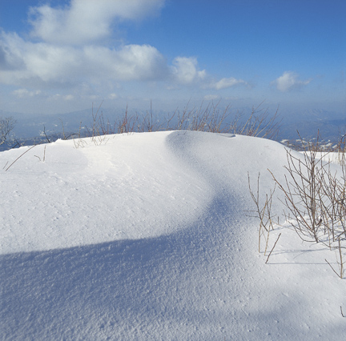
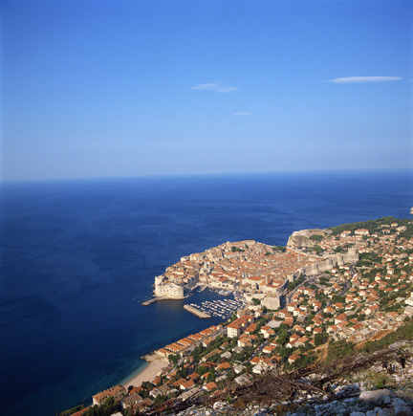
The Interlopers Literary Focus: Omniscient Narrator
Because they know everything, omniscient narrators are free to
reveal any character’s thoughts and feelings,
move from one character’s mind to another’s,
zoom from place to place in a story, and
hold key information from readers.

Slide 7
The Interlopers Literary Focus: Omniscient Narrator
The following passage relies on an omniscient narrator. How can you tell?
Justin’s hand shook, rattling the papers and his nerves. His tongue and throat felt thick. He looked around for a glass of water, but all he could see were rows of faces—watching him, waiting for him to speak.
Ms. Wilson raised her eyebrows, encouraging Justin to begin. She watched anxiously from the front row. He was ready; she was certain. They had been working on his speech for weeks now.
Justin’s hand shook, rattling the papers and his nerves. His tongue and throat felt thick. He looked around for a glass of water, but all he could see were rows of faces—watching him, waiting for him to speak.
Ms. Wilson raised her eyebrows, encouraging Justin to begin. She watched anxiously from the front row. He was ready; she was certain. They had been working on his speech for weeks now.
The narrator reveals the thoughts and feelings of Justin and Ms. Wilson, moving from the mind of one character to the next.

Slide 8
The Interlopers Literary Focus: Omniscient Narrator
Listen to the following selection from “The Interlopers” by Saki.
What characteristics of an omniscient narrator does the passage demonstrate?
The feud might, perhaps, have died down or been compromised if the personal ill will of the two men had not stood in the way; as boys they had thirsted for one another’s blood, as men each prayed that misfortune might fall on the other. . . .
[End of Section]

Slide 9
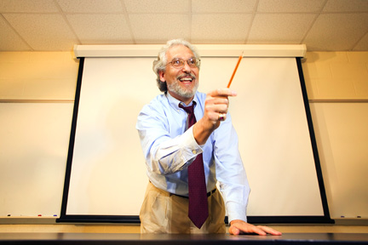
The Interlopers Reading Focus: Drawing Conclusions
When you read, you act like a detective.
You must gather evidence . . .
and draw conclusions based on that evidence.

Slide 10
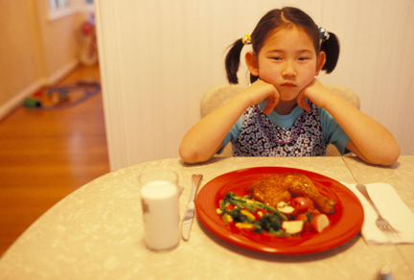
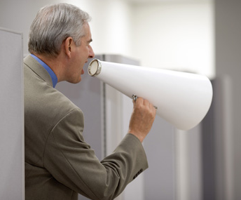
The Interlopers Reading Focus: Drawing Conclusions
As you read, you may draw conclusions about
what characters are really like,
how people respond to situations, and
whether or not a character’s actions are justified.
envious
stubborn
overreacting

Slide 11
The Interlopers Reading Focus: Drawing Conclusions
Into Action: Look for story elements that you think are significant or meaningful. Put these details together to draw conclusions based on the text.
Into Action: Significant Story Details
Story Detail
My Knowledge
My Conclusion
Like their families, Ulrich and Georg have been enemies for years.
Some people are enemies because of family history, not because they know and dislike each other.
Ulrich and Georg may dislike each other out of family loyalties alone— not for any logical reasons.
[End of Section]

Slide 12
The Interlopers Writing Focus: Think as a Reader/Writer
Find It in Your Reading
Notice how the narrator gives us details about characters’ situations, thoughts, and feelings.
The two enemies stood glaring at one another for a long silent moment. Each had a rifle in his hand, each had hate in his heart and murder uppermost in his mind. The chance had come to give full play to the passions of a lifetime.
What are some examples in which the narrator describes what each character thinks or feels?
[End of Section]

Slide 13
Vocabulary

Slide 14
The Interlopers Vocabulary
disputed v. used as adj.: subject of an argument.
marauders n. pl.: people who roam in search of loot, or goods to steal; raiders.
exasperation n.: state of great annoyance.
condolences n. pl.: expressions of sympathy.
reconciliation n.: friendly end to a quarrel.

Slide 15
The Interlopers Vocabulary
Disputed is often used as a verb: She disputed (argued against) the writer’s conclusions.
As an adjective, disputed is used to describe the subject of an argument: The disputed conclusions led to some interesting class debates.
What would dispute mean if it were used as a noun?

Slide 16
The Interlopers Vocabulary
The disputed theory caused quite a stir in the scientific community.
What is likely to be true of the theory?
All scientists agree on its truth.
It lacks sufficient evidence.
It has been completely tested.

Slide 17
The Interlopers Vocabulary
The disputed theory caused quite a stir in the scientific community.
What is likely to be true of the theory?
All scientists agree on its truth.
It lacks sufficient evidence.
It has been completely tested.

Slide 18
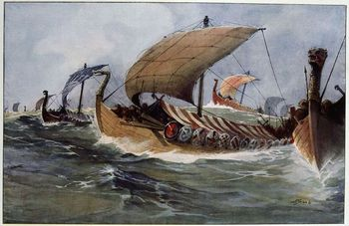
The Interlopers Vocabulary
To maraud is to raid in search of goods. Marauders are those who commit these raids.
A thousand years ago, the Vikings of Scandinavia were known as fierce marauders who sailed throughout Europe, raiding and robbing coastal villages.
What kinds of activities would lead people to consider the Vikings marauders?

Slide 19
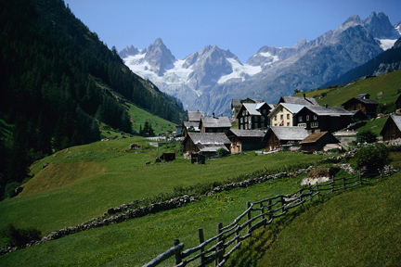
The Interlopers Vocabulary
As marauders descended from the hills, many villagers fled their homes.
Why did the villagers react this way?
They were about to be robbed.
They were tired of the frequent mudslides.
They were afraid of the spreading wildfire.

Slide 20
The Interlopers Vocabulary
As marauders descended from the hills, many villagers fled their homes.
Why did the villagers react this way?
They were about to be robbed.
They were tired of the frequent mudslides.
They were afraid of the spreading wildfire.

Slide 21
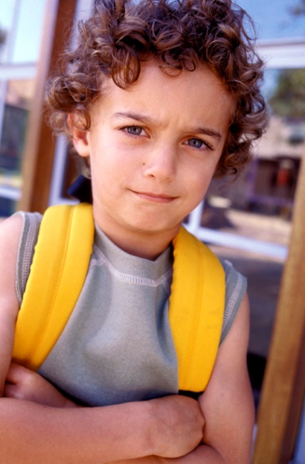
The Interlopers Vocabulary
If a person feels exasperated, he or she feels greatly annoyed.
How might people express exasperation?
What situations create a sense of exasperation?

Slide 22
The Interlopers Vocabulary
After he finished taking his driving test, John wore a look of exasperation on his face.
Why might John look exasperated?
He was excited to earn his license.
He had failed the test.
His father said he could borrow the car.

Slide 23
The Interlopers Vocabulary
After he finished taking his driving test, John wore a look of exasperation on his face.
Why might John look exasperated?
He was excited to earn his license.
He had failed the test.
His father said he could borrow the car.

Slide 24
The Interlopers Vocabulary
Many people offer condolences, or expressions of sympathy, when a loved one passes away.
Offering condolences lets someone know that you sympathize with his or her pain and loss.
Why might the doctor be giving his condolences to these two women?

Slide 25
The Interlopers Vocabulary
Please remind me to send a card to Aunt Susie to express my condolences.
What kind of card would be most appropriate?
“Thinking of You”
“Thank You”
“Congratulations”

Slide 26
The Interlopers Vocabulary
Please remind me to send a card to Aunt Susie to express my condolences.
What kind of card would be most appropriate?
“Thinking of You”
“Thank You”
“Congratulations”

Slide 27
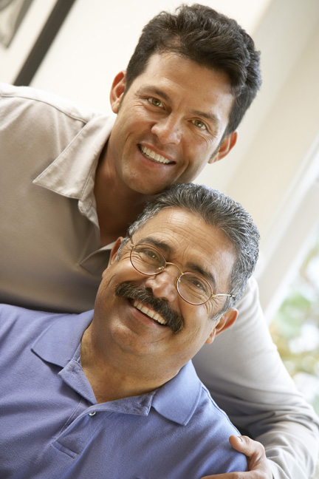
The Interlopers Vocabulary
Marco ended the quarrel with his adult son. Their reconciliation had a wonderful result.
He was able to see his grandson more often.
What kind of feelings would a reconciliation bring about?

Slide 28
The Interlopers Vocabulary
The sisters’ reconciliation brought harmony back into the household.
How did the sisters behave before their reconciliation?
They spent a lot of time together.
They helped each other with chores.
They argued a lot.

Slide 29
The Interlopers Vocabulary
The sisters’ reconciliation brought harmony back into the household.
How did the sisters behave before their reconciliation?
They spent a lot of time together.
They helped each other with chores.
They argued a lot.
[End of Section]
Notes:
.

Slide 30
The End

Slide 31
QuickWrite

Slide 32
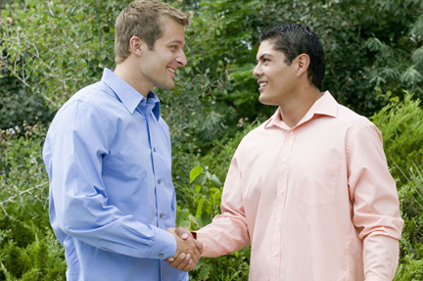
The Interlopers QuickWrite
Think about enemies who have become friends.
What happened to help end the fighting?
Write down a few examples.
[End of Section]

Slide 33
Meet the Writer

Slide 34
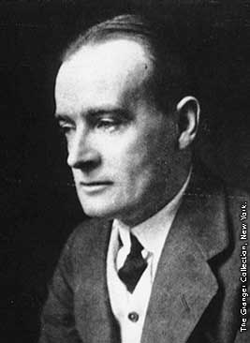
The Interlopers Meet the Writer
Saki—Hector Hugh Munro (1870–1916)—was born in Burma, where his father was an officer in the military police.
After the death of his mother, Saki and his two older siblings were sent to England to live with their grandmother and two strict aunts.
More About the Writer

Slide 35
The Interlopers Meet the Writer
When he was twenty-three, Saki became a policeman, but he took little interest in his job.
When he began to write political satires, he adopted the pen name Saki. The name was that of the character who served wine to the gods in the then-popular poem the Rubáiyát of Omar Khayyám.
More About the Writer
[End of Section]

Slide 36
Build Background

Slide 37
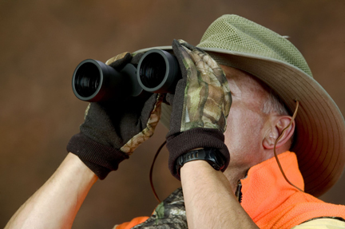
The Interlopers
Build Background
In the time and place of this story, ownership of land is gone. Animals are hunted as a source of food and pelts.
Hunting illegally on someone else’s property is called poaching.
Arguments over land have sometimes made enemies of neighbors.
[End of Section]

Slide 38
Preview the Selection

Slide 39
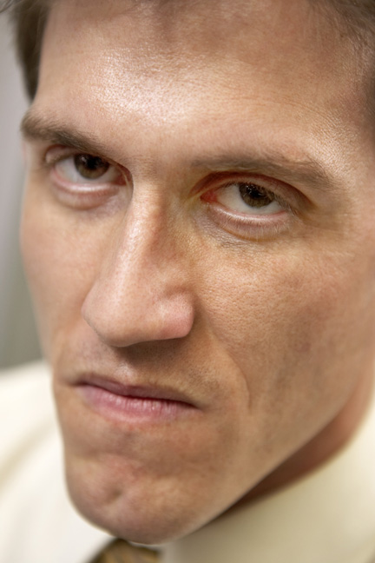
The Interlopers
Preview the Selection
Ulrich and Georg are bitter enemies. Their families have hated each other for generations.
Suddenly they’re both stuck in the same situation— one that will have a shocking resolution.
[End of Section]

